Slide 1
COMPUTING DERIVATIVES
During the last lecture we saw that we need some “bricks” (derivatives of actual functions) and some “mortar” (commonly known as “rules of differentiation.”)
We list and prove the rules first, they are rather easy to prove. Let us state all five of them as one theorem, and prove it.
Here we go:
Notes:
W for whatever, …

Slide 2



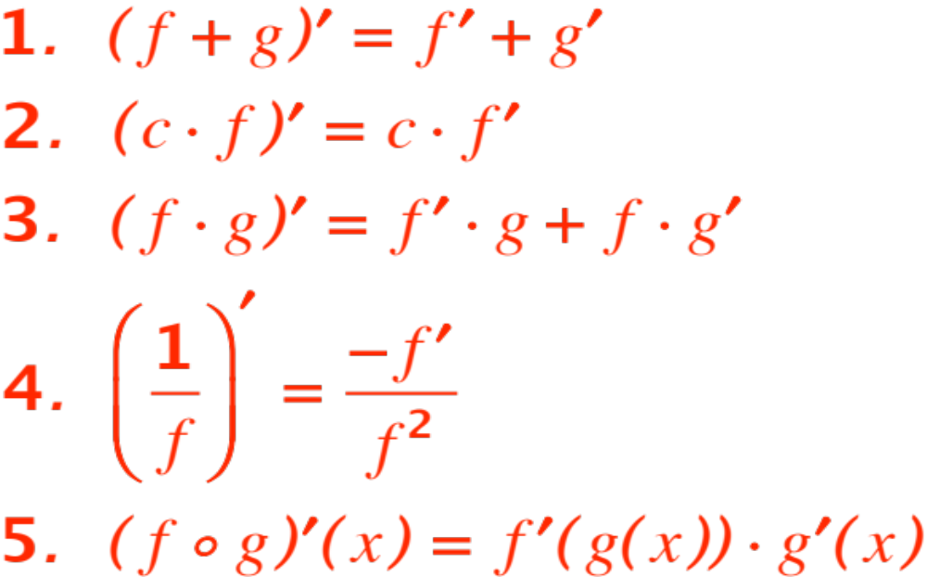
Theorem. Let and be differentiable at the point . Then

Slide 3

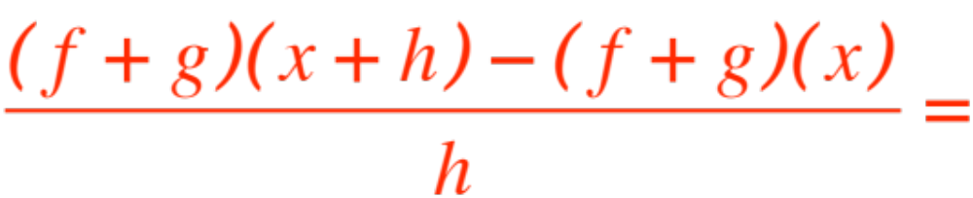
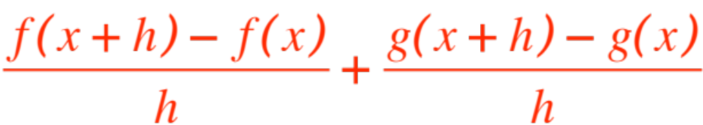
The proof follows the same pattern:
Write the difference quotient.
Fiddle with it until you can compute its limit.
We write
Now take the limit.

Slide 4
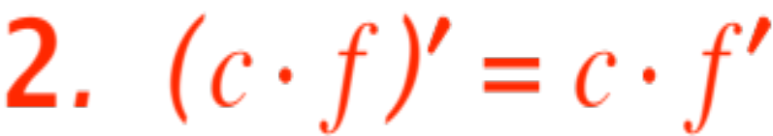
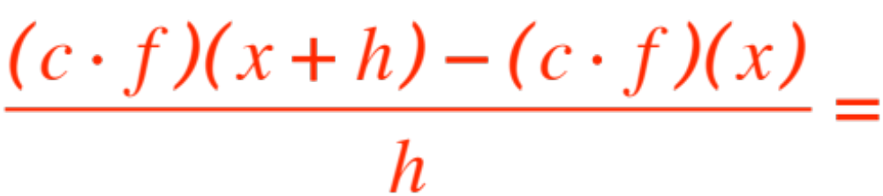
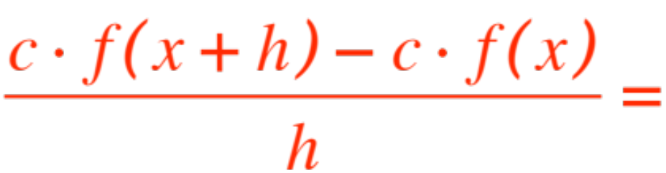
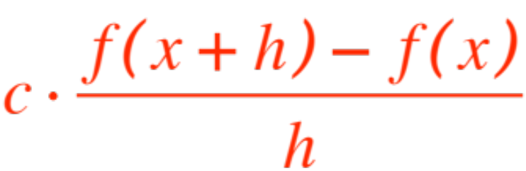
Next:
We write
Now take the limit.

Slide 5

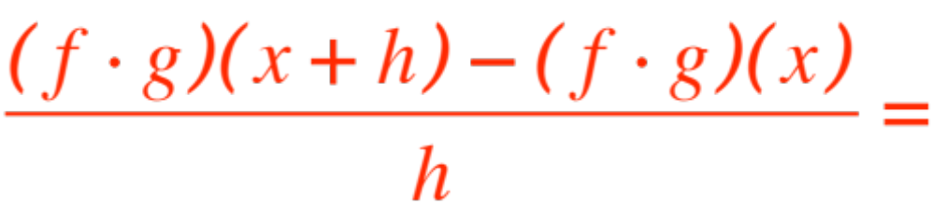
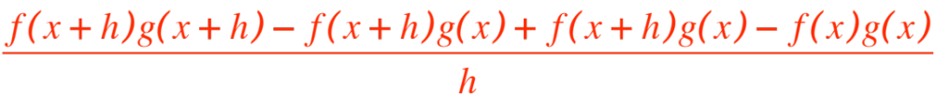
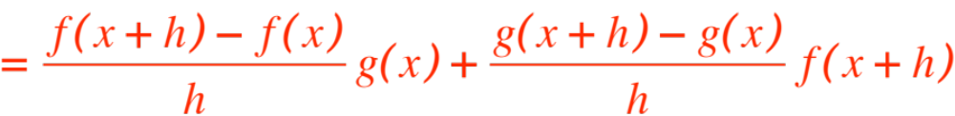
Next: (a little tricky, we drop the )
We write
Now take the limit

Slide 6
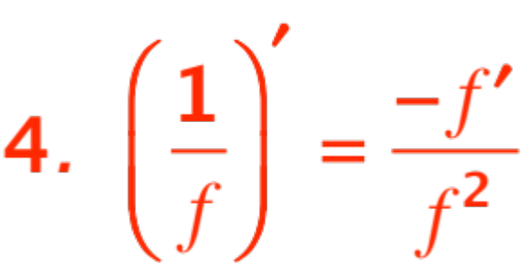
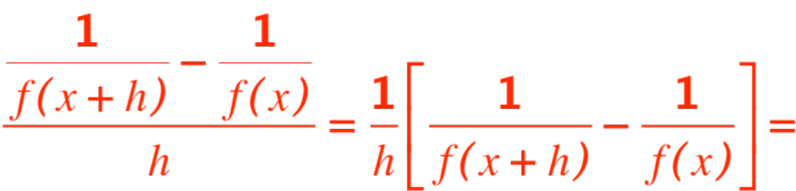
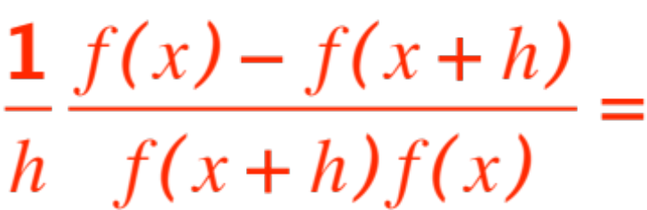
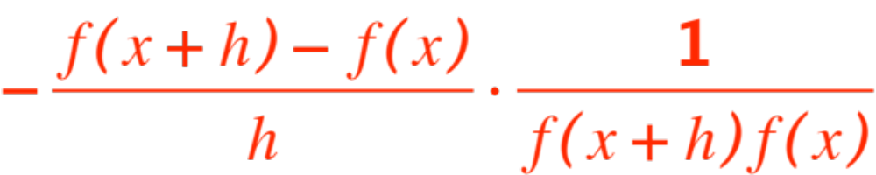
Next:
take a limit

Slide 7
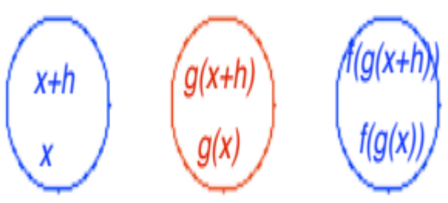
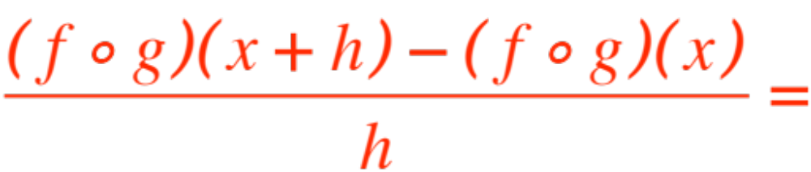
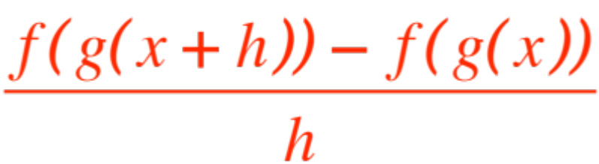
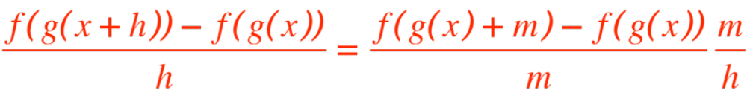
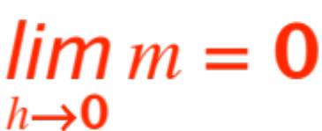
Next:
Now let
and get
Note that (g is continuous), hence

Slide 8



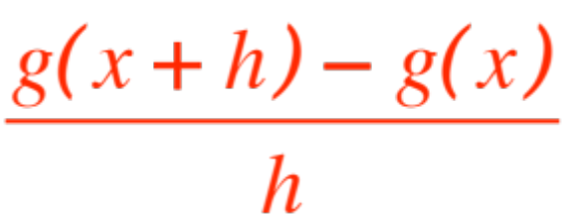
the first fraction approaches as
approaches . The second fraction is
Now look at
and take a limit. QED
Now to get some bricks and start “building”.
The number of bricks is also 5, but you will do the fifth one next semester, so I will list it without proof.

Slide 9




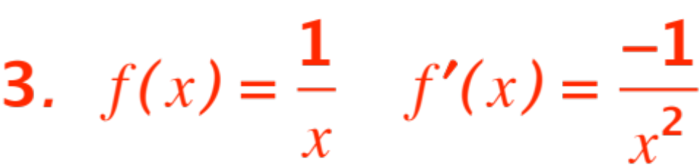
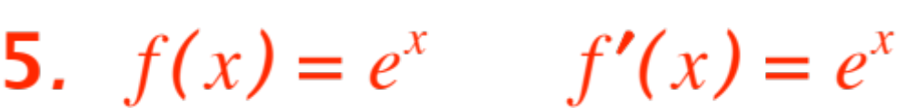
Theorem. If is as specified, is as shown.
Proof. (Remember that you will prove 5. next semester.)

Slide 10
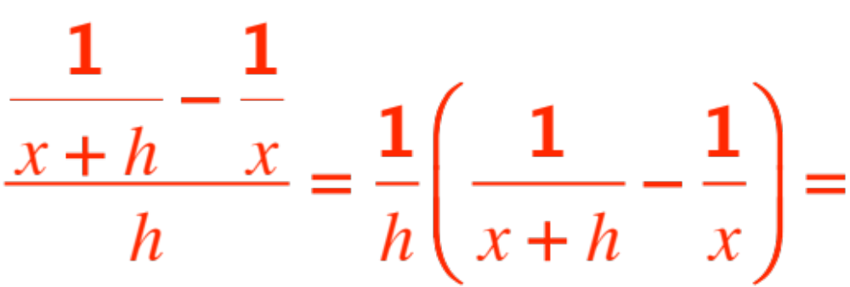
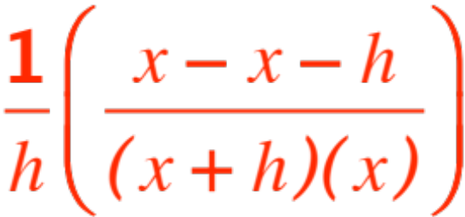

The strategy of the proof is the same as before:
Write the difference quotient.
Fiddle with it until you can compute its limit.
I will not insult your intelligence by proving 1. and 2.
We’ve done 3. before, but here we go anyway:
Cancel the two ‘s and take a limit.

Slide 11
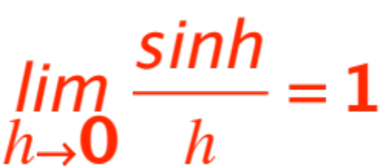
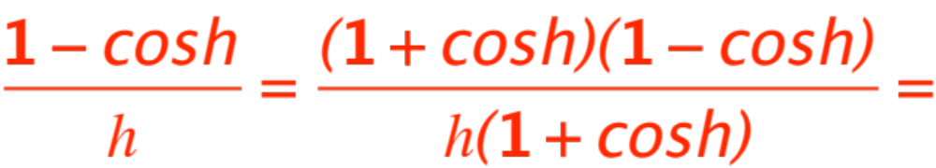
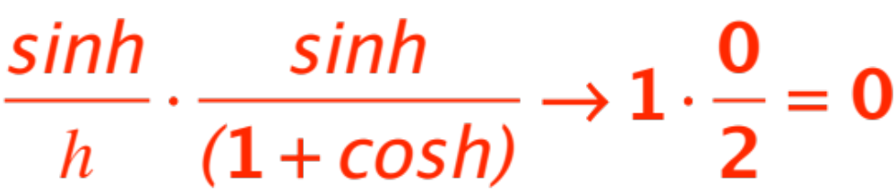
In order to prove 4. we need one simple fact from trigonometry, namely that
(fact)
Be kind and grant me this fact, so I can finish the proof, then we will prove the fact. OK ? I need to look at

Slide 12
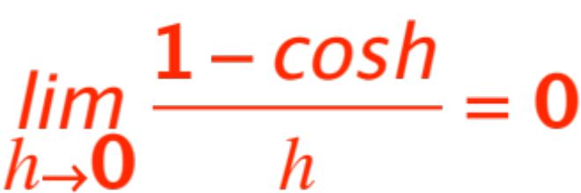
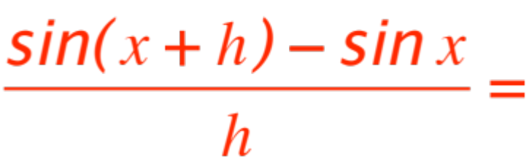
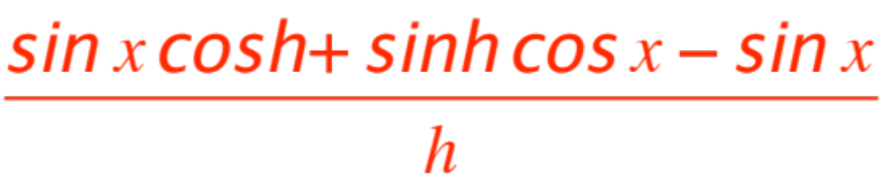
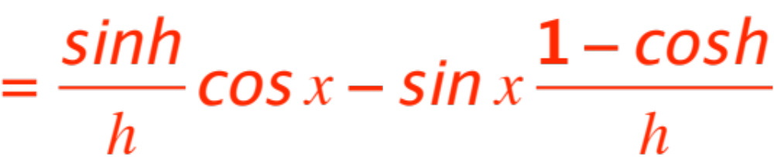
From the fact we have established that
Now the difference quotient for the sine:
take a limit.
To prove the fact look at the picture

Slide 13
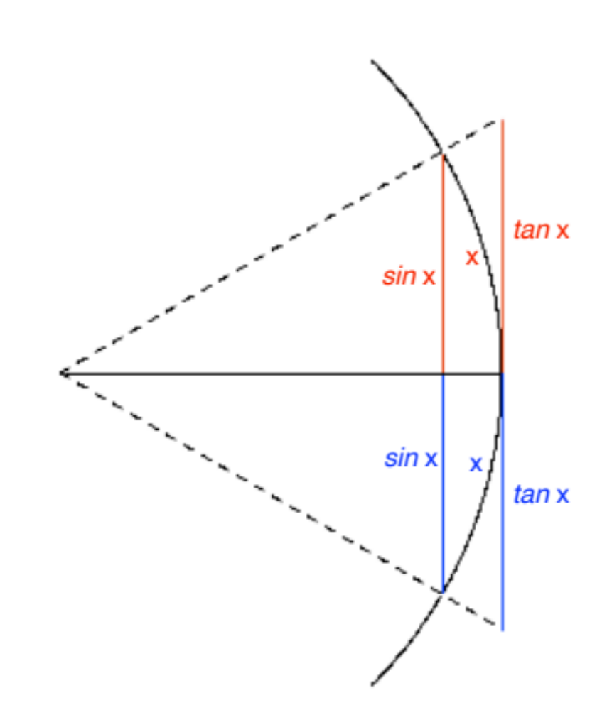

Remember that “radians” measure arc length when the radius is 1.

Slide 14
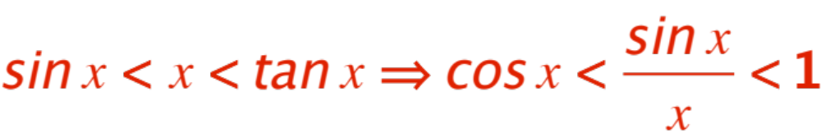
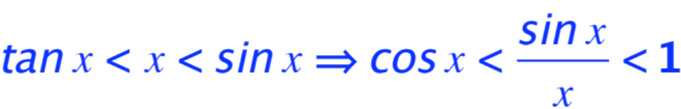
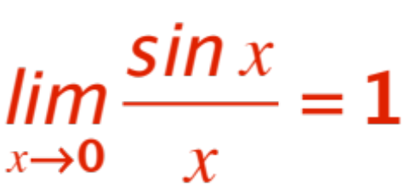
Remembering that inequalities reverse when multiplied by a negative we get:
In both cases the “squeeze” (carabinieri) theorem gives us the fact
Now we have bricks and mortar, let’s build!

